Slide 1
The Imaging X-ray Polarimetry Explorer (IXPE)
Martin C. Weisskopf, IXPE PI, MSFC
On behalf of the entire IXPE team

Slide 2
IXPE accomplishes new science with new capabilities
Opens a new window on the universe — imaging (30“) X-ray polarimetry
  Is the science driver that advances and impacts high-energy astrophysics
  Increases information space and lifts modeling degeneracies
Addresses key questions, providing new scientific results and constraints
  What is the spin of a black hole?
  What are the geometry and magnetic-field strength in magnetars?
  Was our Galactic Center an Active Galactic Nucleus in the recent past?
  What is the magnetic field structure in synchrotron X-ray sources?
  What are the geometries and origins of X-rays from pulsars (isolated and accreting)?
Provides powerful and unique capabilities
  Reduces integration time by a factor of 100 compared to the OSO-8 experiment
  Simultaneously provides imaging, spectral, timing, and polarization data
  Is free of false-polarization systematic effects at less than a fraction of a percent
  Enables meaningful polarization measurements for many sources of different classes

Slide 3
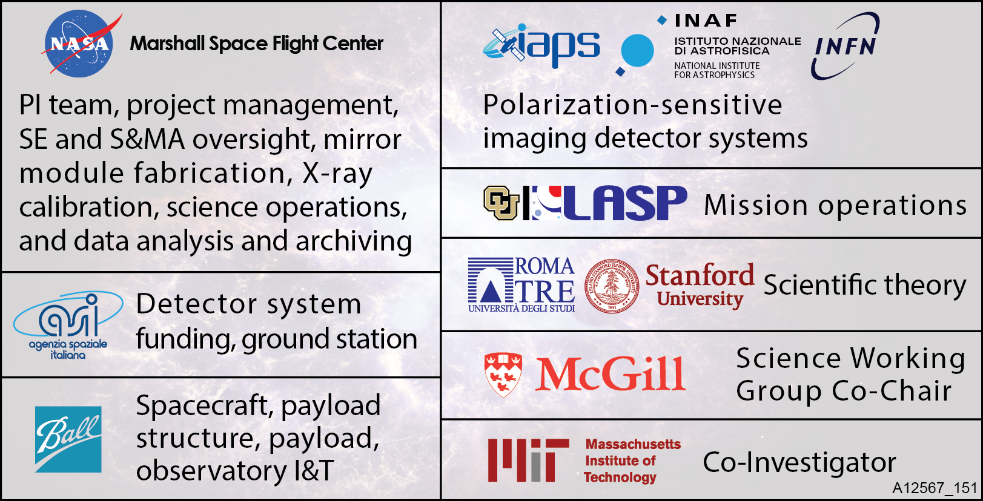
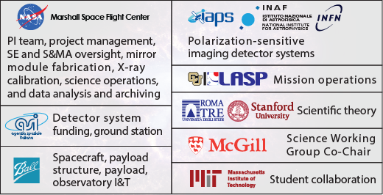










Who is involved?
Institutional Roles and Responsibilities
Science Advisory Team
Co-Investigators: Luca Baldini, Ronaldo Bellazzini, Enrico Costa, Ronald Elsner, Victoria Kaspi, Jeffery Kolodziejczak, Luca Latronico, Herman Marshall, Giorgio Matt, Fabio Muleri, Stephen L. O’Dell, Brian D. Ramsey, Roger W. Romani, Paolo Soffitta, Allyn Tennant
Collaborators: A. Brez, N. Bucciantini, E. Churazov, S. Citrano, E. Del Monte, N. Di Lalla, I. Donnarumma,
M. Dovčiak, Y. Evangelista, S. Fabiani, R. Goosmann, S. Gunji, V. Karas, M. Kuss, A. Manfreda, F. Marin,
M. Minuti, N. Omodei, L. Pacciani, G. Pavlov, M. Pesce-Rollins, P.-O. Petrucci, M. Pinchera, J. Poutanen, M. Razzano,
A. Rubini, M. Salvati, C. Sgrò, F. Spada, G. Spandre, L. Stella, R. Sunyaev, R. Taverna, R. Turolla, K. Wu, S. Zane, D. Zanetti

Slide 4
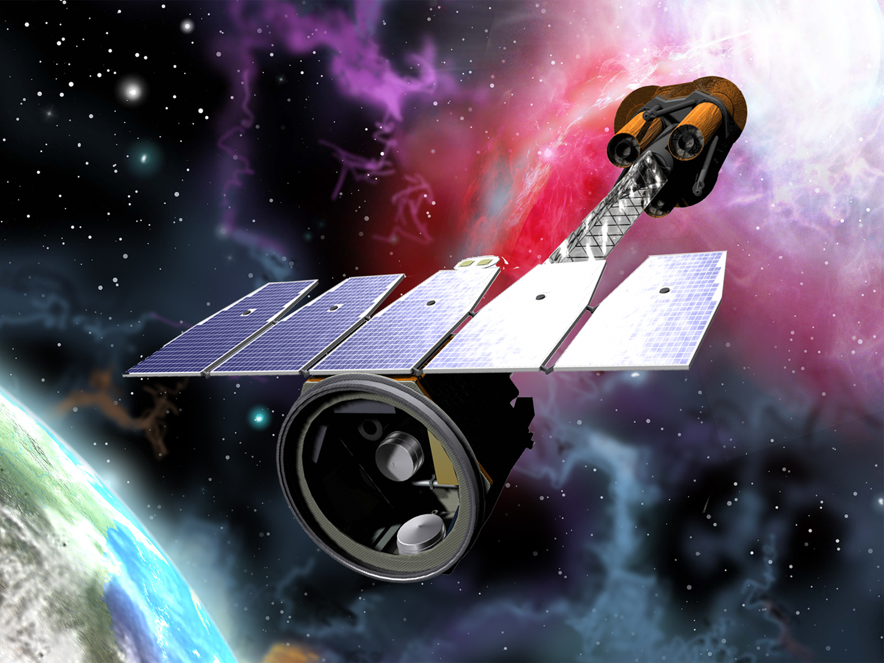
Three sets of identical X-ray mirror modules and imaging polarization sensitive detectors

Slide 5
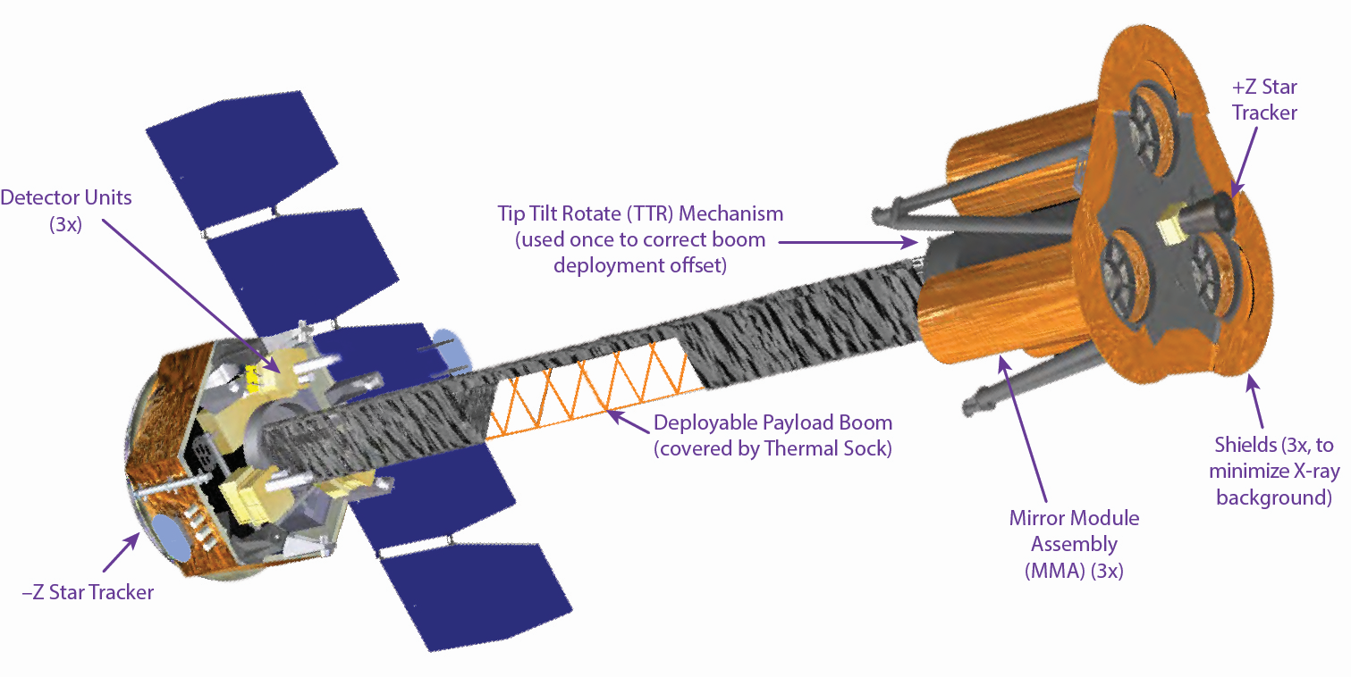
Three sets of identical X-ray mirror modules and imaging polarization sensitive detectors

Slide 6
The X-ray mirror modules
Parameter | Value
Number of mirror modules | 3
Number of shells per mirror module | 24
Focal length | 4000 mm
Total shell length | 600 mm
Range of shell diameters | 162–272 mm
Range of shell thicknesses | 0.16–0.26 mm
Shell material | Electroformed nickel–cobalt alloy
Effective area per mirror module | 230 cm² (@ 2.3 keV); >240 cm² (3–6 keV)
Angular resolution (HPD) | ≤ 25 arcsec
Field of view (detector limited) | 12.9 arcmin square

Slide 7
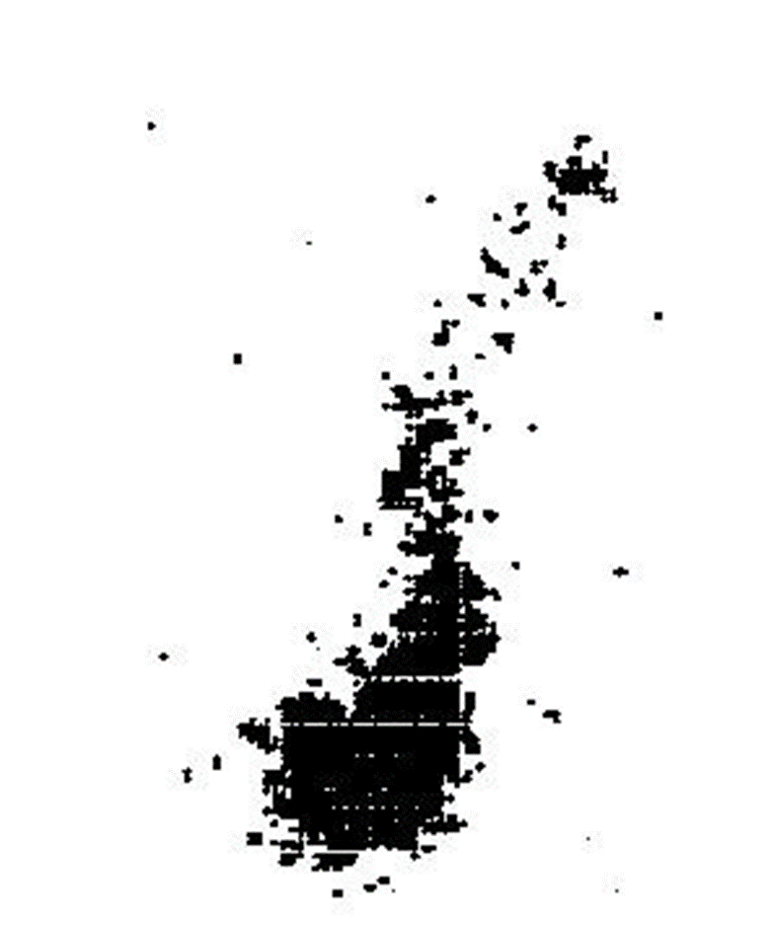
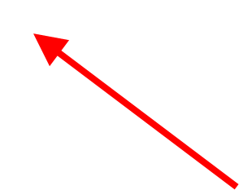
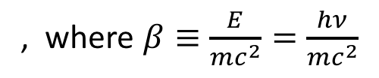
the polarization sensitive detectors
The initial direction of the K-shell photoelectron is determined by the electric vector
, where $β≡\frac{E}{mc^{2}}=\frac{hν}{mc^{2}}$
Initial direction of photoelectron
Site of initial ionization and Auger electron cloud
The distribution of the photoelectron directions determines the degree of polarization and the position angle

Slide 8
the polarization sensitive detectors
Parameter | Value
Sensitive area | 15 mm × 15 mm
Fill gas and composition | He/DME (20/80) @ 1 atm
Detector window | 50-µm thick beryllium
Absorption and drift region depth | 10 mm
GEM (gas electron multiplier) | copper-plated 50-µm liquid-crystal polymer
GEM hole pitch | 50 µm triangular lattice
Number ASIC readout pixels | 300 × 352
ASIC pixelated anode | Hexagonal @ 50-µm pitch
Spatial resolution (FWHM) | ≤ 123 µm (6.4 arcsec) @ 2 keV
Energy resolution (FWHM) | 0.54 keV @ 2 keV (∝ √E)

Slide 9
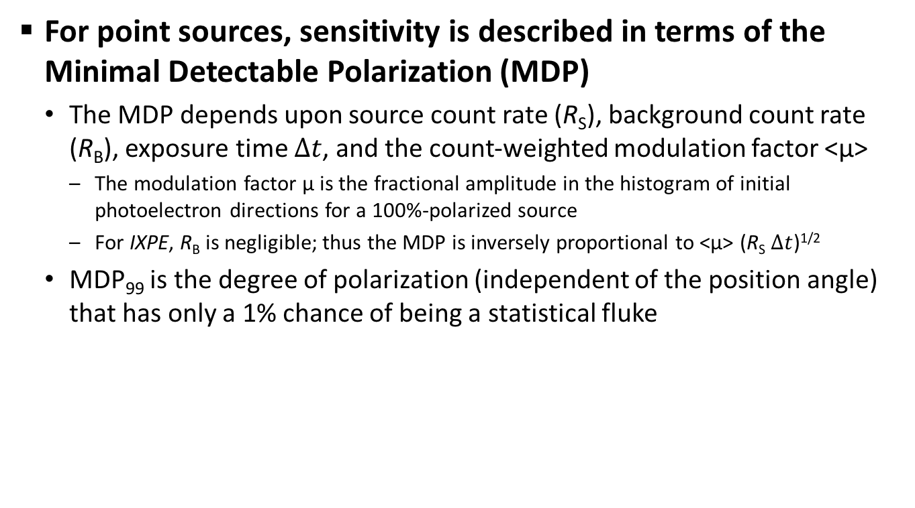
Polarization sensitivity
For point sources, sensitivity is described in terms of the Minimal Detectable Polarization (MDP)
  The MDP depends upon source count rate (R_{S}), background count rate (R_{B}), exposure time $Δt$, and the count-weighted modulation factor <µ>
    The modulation factor µ is the fractional amplitude in the histogram of initial photoelectron directions for a 100%-polarized source
    For IXPE, R_{B} is negligible; thus the MDP is inversely proportional to <µ> (R_{S} $Δt$)^{1/2}
  MDP₉₉ is the degree of polarization (independent of the position angle) that has only a 1% chance of being a statistical fluke
For IXPE,

Slide 10
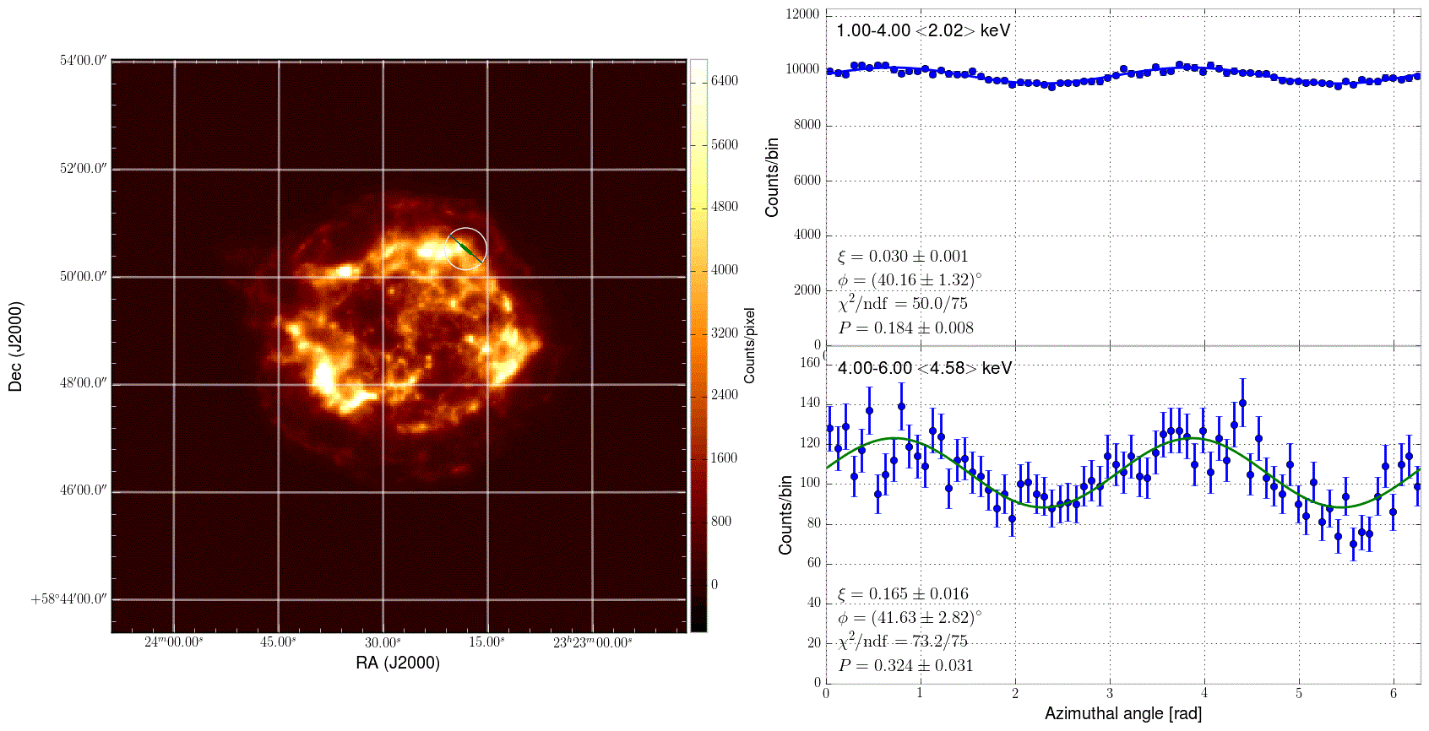
Map magnetic field of synchrotron sources to probe sites of cosmic-ray acceleration: Cas A
Lines and thermal continuum dominate 1-4 keV
Non-thermal emission dominates 4-6 keV
HPD
Cas A image at IXPE resolution (1.5-Ms)

Slide 11
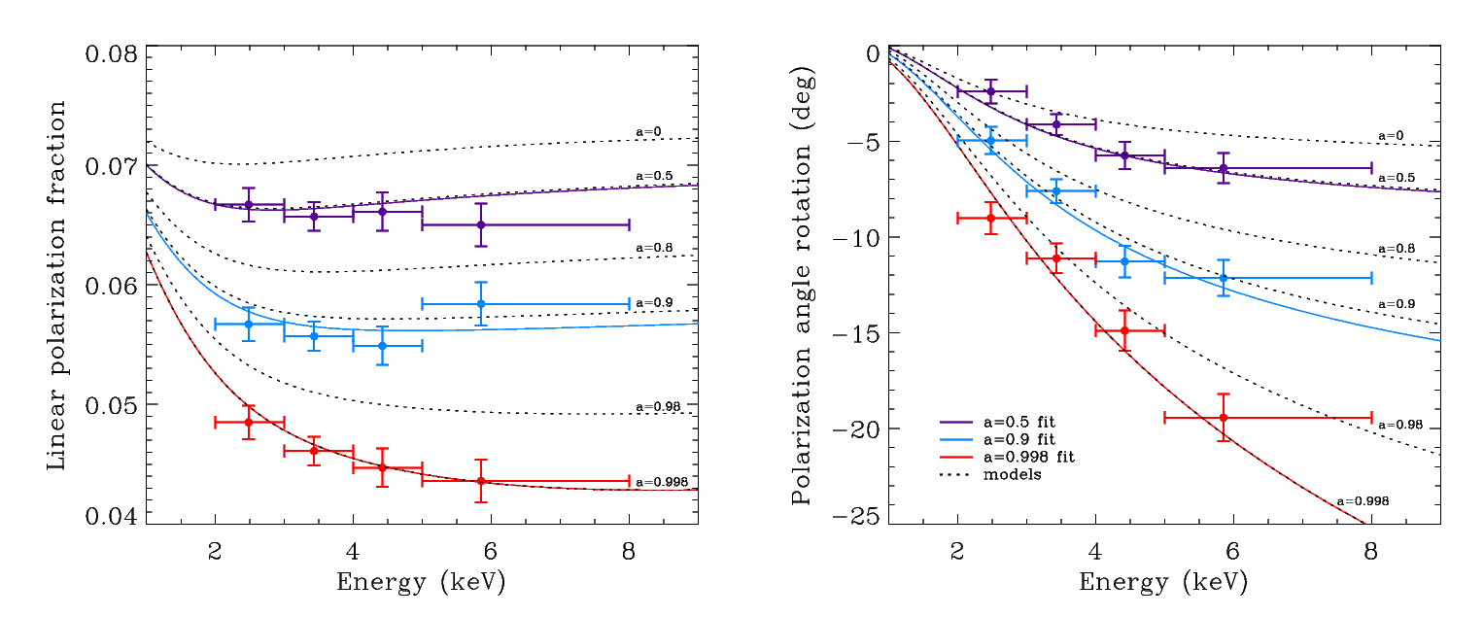
Measure black-hole spin from polarization rotation in twisted space-time: GRX1915+105
For a micro-quasar in an accretion-dominated state
  Scattering polarizes the thermal disk emission
  Polarization rotation is greatest for emission from inner disk
    Inner disk is hotter, producing higher energy X-rays
  Priors on disk orientation constrain GRX1915+105 model
    a = 0.50±0.04; 0.900±0.008; 0.99800±0.00003 (200-ks observation)
Notes:
200-ks observation

Slide 12
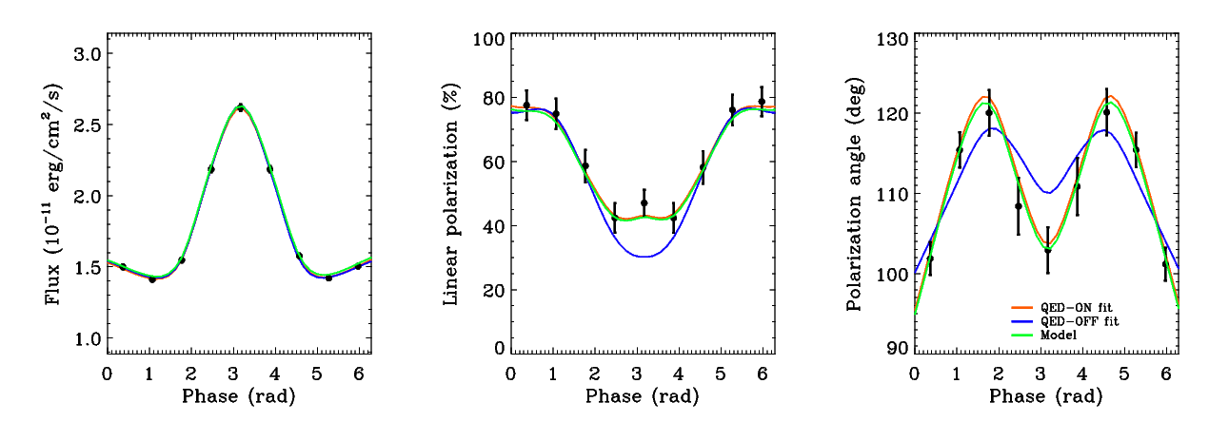
Test quantum electrodynamics (QED) in ultra-strong magnetic fields
Magnetar is a neutron star with magnetic field up to 10¹⁵ Gauss
  Non-linear QED predicts magnetized-vacuum birefringence
    Refractive indices of the two polarization modes differ from 1 and from each other
    Impacts polarization and position angle as functions of pulse phase, but not the flux
  Example is the magnetar 1RXS J170849.0-400910, with an 11-s pulse period
    Can exclude QED-off at better than 99.9% confidence in 250-ks observation

Slide 13
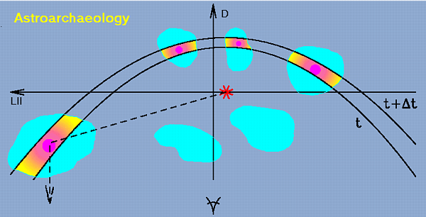
Was Sgr A* recently 10⁶ × more active?
Galactic Center molecular clouds (MC) are known X-ray sources
  If MCs reflect X-rays from Sgr A* (supermassive black hole in the Galactic center)
    X-radiation would be highly polarized perpendicular to plane of reflection and indicates the direction back to Sgr A*
    Sgr A* X-ray luminosity was 10⁶ larger ≈ 300 years ago
  If not, still a discovery

Slide 14
Probe emitting regions of pulsars through phase-resolved polarimetry: Crab Pulsar
Grey = optical
Emission geometry and processes are unsettled
  Competing models predict differing polarization behavior with pulse phase
X-rays provide cleaner probe of geometry
  Absorption likely more prevalent in visible band
  Radiation process entirely different in radio band
    Recently discovered no pulse phase-dependent variation in polarization degree and position angle @ 1.4 GHz
140-ks observation gives ample statistics to track polarization degree and position angle

Slide 15
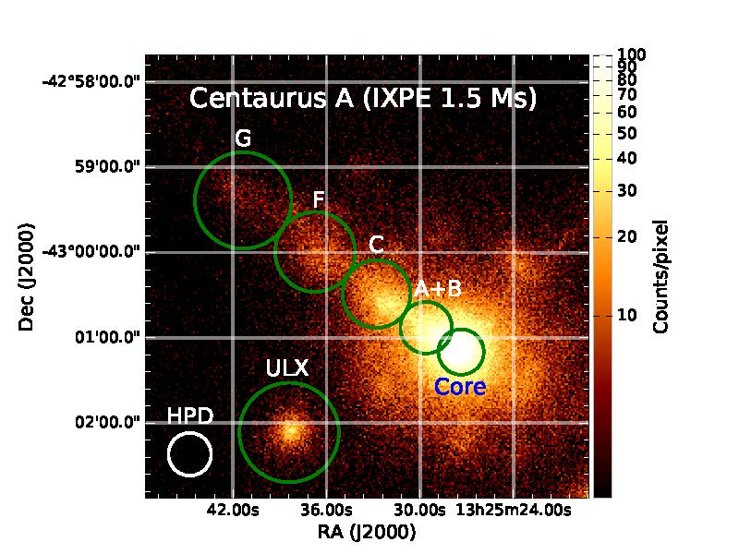
IXPE imaging also avoids confusion and provides serendipitous benefits
Active galaxies are powered by supermassive BHs with jets
  Radio polarization implies the magnetic field is aligned with jet
  Different models for electron acceleration predict different dependence in X-rays
Imaging Cen A allows isolating other sources in the field
  Two Ultra Luminous X-ray sources (one to SW on detector but not visible in 6-arcmin-square displayed region)
Region | MDP₉₉
Core | <7.0%
Jet | 10.9%
Knot A+B | 17.6%
Knot C | 16.5%
Knot F | 23.5%
Knot G | 30.9%
ULX | 14.8%
Includes effects of dilution by unpolarized diffuse emission

Slide 16

Capturing the public’s imagination

